Slide 1
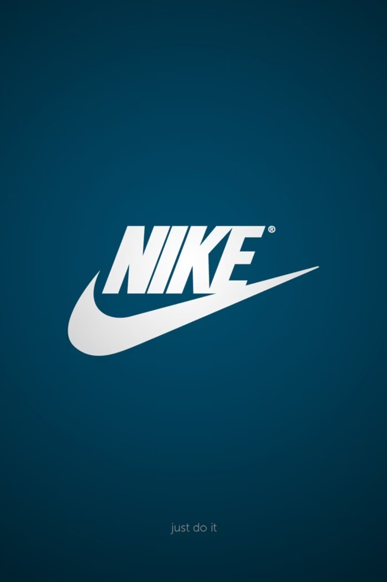
NIKE Inc.
Financial Ratio Analysis and Modeling
Financial Health (FY2023–2025)
This presentation provides an analytical overview of NIKE Inc.'s financial performance from Fiscal Year 2023 to 2025, focusing on key liquidity and profitability ratios. We will examine the company's stability, efficiency, and projected sustainable growth rates.

Slide 2
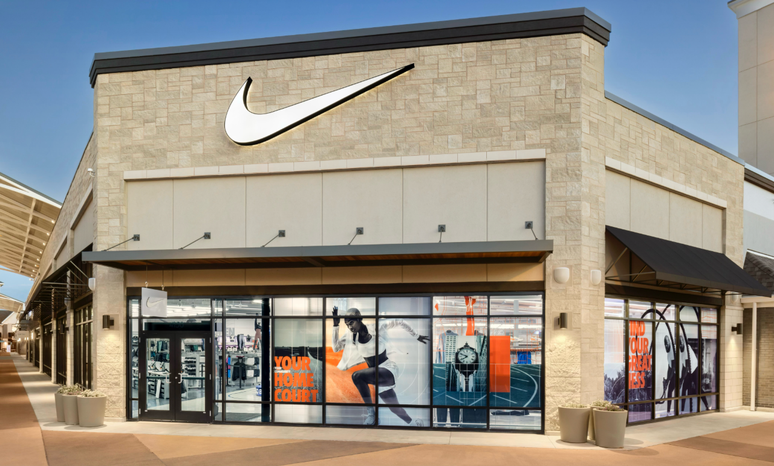

Introduction to the Firm
Global Leader in Athletic Wear
NIKE Inc. (NKE) stands as a global powerhouse in the athletic industry, specializing in footwear, apparel, equipment, and accessories. Headquartered in Beaverton, Oregon, the company primarily operates through its flagship NIKE Brand and the subsidiary Converse.
Its market presence is distributed across key geographic segments: North America, Europe, Greater China, and Asia Pacific, catering to both wholesale channels and a growing direct-to-consumer (DTC) market.
FY2025 Financial Snapshot: NIKE reported $46.3 billion in revenue for the fiscal year ended May 31. The period was marked by challenges, including lower net income resulting from evolving market dynamics and strategic restructuring efforts.
Serving wholesale and direct-to-consumer markets globally.

Slide 3
Core Financial Data: 2023–2025
Key Items from NIKE's Consolidated Financial Statements (in millions of USD)
Item
2023
2024
2025
Current assets
25,202
25,382
23,362
Current liabilities
9,256
10,593
10,566
Cash
7,441
9,860
7,464
Inventory
8,454
7,519
7,489
Total assets
37,531
38,110
36,579
Shareholders’ equity
14,004
14,430
13,213
Net income — consolidated
5,070
5,700
3,219
Note the significant decline in Net Income and Current Assets in FY2025, which will be reflected in the ratio analysis.

Slide 4
Liquidity Ratios: Measuring Short-Term Stability
Liquidity ratios assess NIKE's ability to cover its short-term debt obligations. Healthy ratios are essential for operational stability.
1
2
3
Current Ratio
Quick Ratio (Acid-Test)
Cash Ratio
Formula: Current Assets / Current Liabilities
Formula: (Current Assets - Inventories) / Current Liabilities
Formula: Cash and Equivalents / Current Liabilities
2023: 2.72
2023: 1.81
2023: 0.80
2024: 2.40
2024: 1.69
2024: 0.93
2025: 2.21
2025: 1.50
2025: 0.71
A decline over three years, but still well above the benchmark of 2.0.
Confirms strong liquidity even without selling inventory; drop reflects lower non-inventory current assets.
Demonstrates reliance on receivables and other assets to fully cover liabilities.
All key liquidity ratios have experienced a downward trend over the period, indicating reduced short-term coverage, although they remain at highly sufficient levels for a large retail firm.

Slide 5
Liquidity Analysis: Trends and Implications
Sufficiency of Assets
Inventory and Cash Position
Implications for Stability
The Current Ratio of 2.21 in 2025 shows NIKE has ample current assets to cover its short-term obligations. The Quick Ratio of 1.50 is particularly strong, affirming the company’s ability to meet immediate liabilities without liquidating inventory, which is crucial in the retail sector.
Inventory constitutes approximately 32% of current assets in 2025 ($7,489M / $23,362M). While manageable for retail, management must monitor inventory levels to prevent buildup if sales slow further. Cash (32% of current assets) is adequate but significantly lower than the prior year (2024 Cash Ratio: 0.93).
The 19% decline in the Current Ratio (2023 to 2025) suggests tightening liquidity, but the ratios remain healthy. Short-term operational stability is secure, yet the sharp decline in cash (Cash Ratio dropped 24% from 2024) indicates a need for cautious financial management amid reported revenue declines.

Slide 6






Profitability Ratios: Return on Investment
These ratios evaluate how effectively NIKE generates profit from its assets and shareholder investments. The significant drop in Net Income in 2025 heavily impacts these metrics.
ROE = Net Income / Shareholders’ Equity
Return on Equity (ROE)
2023: 36.2%
ROA= Net Income​ / Total Assets
2024: 39.5%
Return on Assets (ROA)
2025: 24.4%
2023: 13.5%
2024: 15.0%
EM = Total Assets / Shareholders’ Equity
2025: 8.8%
Equity Multiplier
2023: 2.68
2024: 2.64
2025: 2.77

Slide 7
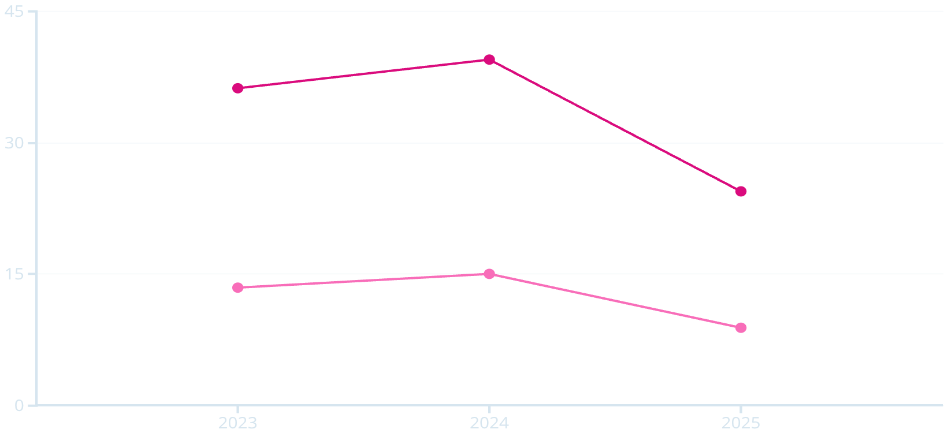
Analysis of Profitability Decline
The sharp decline in profitability, particularly in FY2025, requires further examination using the DuPont disaggregation model.
Return on Equity (ROE) Trend
ROE increased from 36.2% in 2023 to its peak of 39.5% in 2024, reflecting improved utilization of shareholder capital. However, it plummeted to 24.4% in 2025, a significant 15.1 percentage point decline year-over-year.
The Driver: This drop is primarily attributable to the lower net income ($5,700M in 2024 down to $3,219M in 2025).
Impact on Assets: Similarly, ROA fell from 15.0% to 8.8%, showing that the company became substantially less efficient at generating profit from its total asset base in 2025.
ROE
ROA

Slide 8



DuPont Decomposition: ROE = ROA x Equity Multiplier
Analyzing the components reveals the underlying cause of the 2025 profitability shift.
2024 ROE (39.5%)
2025 ROE (24.4%)
Mitigating Factor: Leverage
Supported by a healthy ROA (15.0%) and moderate leverage (2.64).
The primary cause of the 15.1-point decline was the sharp drop in ROA (from 15.0% to 8.8%), driven by lower net income.
A slight increase in the Equity Multiplier (leverage) from 2.64 to 2.77 partially offset the ROA decline, preventing an even steeper fall in ROE.
Insight: While higher leverage helped maintain shareholder returns temporarily, reliance on debt to sustain ROE is riskier if underlying profitability (ROA) does not recover.

Slide 9




Modeling Sustainable Growth Rates (2025)
The Sustainable Growth Rate (SGR) determines the maximum growth a company can achieve without issuing new equity or changing its debt-to-equity ratio.
Retention Ratio (b) = 1 - (Dividends / Net Income) = 1 - (2,300 / 3,219) = 0.285
Calculations are based on the Retention Ratio (b) of 0.285, calculated from $2,300M in dividends paid out of $3,219M Net Income.
1. Internal Growth Rate (IGR)
2. Sustainable Growth Rate (SGR)
Max Growth without External Financing
Max Growth Maintaining Capital Structure
(0.088 × 0.285) / (1 - 0.088 × 0.285) = 2.6%
(0.244 × 0.285) / (1 - 0.244 × 0.285) = 7.5%
IGR = 2.6%
SGR = 7.5%
This modest rate implies that NIKE’s organic growth, funded only by retained earnings and excluding new debt, will be limited. This is common for a mature, large-cap company like NIKE.
The higher SGR leverages NIKE's existing financial structure (debt/equity mix). This rate supports moderate sales growth while maintaining current shareholder returns and capital ratios.

Slide 10
Conclusion: Key Takeaways for NIKE Inc.
1
Liquidity Remains Strong but is Declining
2
Profitability Sharp Decline is Concerning
The severe drop in Net Income drove ROA and ROE down dramatically in FY2025. This signals internal efficiency issues or pressure from market dynamics that must be addressed to stabilize earnings.
Ratios are high (Current Ratio 2.21, Quick Ratio 1.50) and assure short-term stability. However, the consistent downward trend suggests reduced flexibility, particularly the tightening cash position in 2025.
3
Growth is Moderate and Leveraged
4
Strategic Focus
The Internal Growth Rate (2.6%) is low, requiring external financing for high growth. The Sustainable Growth Rate (7.5%) is acceptable but depends on maintaining the current level of financial leverage.
Management must prioritize strategies to boost net income and ROA, reducing reliance on financial leverage (Equity Multiplier) to sustain ROE in the long term.

Slide 11


